Slide 1
Ontology-Driven Data Preparation for Data Mining
Martin Zeman, KSI MFF UK
Martin Ralbovský, KIZI FIS VŠE

Slide 2
Possible usage of domain ontologies in the KDD process
Knowledge discovery x knowledge storage
Data understanding phase
Knowledge from ontology helps to comprehend the domain
Task design phase
Define meaningful tasks with aid of ontology
Result interpretation phase
How do KDD results cope with ontology knowledge

Slide 3
Previous works
Theoretically high ☺ (methodology)
Practically low ☹ (manual experiments, no real software support)
Main goal: software support for some of the ontology support ideas
Implementation platform: Ferda

Slide 4
How to load ontology?
1st problem: how to load ontology?
Ontology language – OWL 1.1
Available software usage – OWL API
Technical situation
Ferda - .NET + ICE Middleware
OWL API – Java

Slide 5
How to load ontology?
Ontology Module
Ontology Box
ICE
Java
.NET
Java
.NET
.NET
Java
Box API
OWL API

Slide 6
Mapping
2nd problem: how to connect ontology and database?
Columns
Table or database
Classes and instance
Mapping
Relation- 1:N, M:1, M:N?

Slide 7
Creation of attributes
Proper categorization of domains – crucial step for successful KDD (not only in GUHA)
Example: blood pressure above 140/90 mm Hg is considered as hypertension
Categorization information available in ontology?

Slide 8
Additional information
Cardinality (nominal/ordinal/ordinal cyclic/cardinal)
Maximum
Minimum
Domain dividing values
Distinct values
Saving information to ontology
Datatype properties
Domain: metaclass owl:class
Advantages
Inherent part of the domain
Reusability
Not restricted to KDD (GUHA)

Slide 9
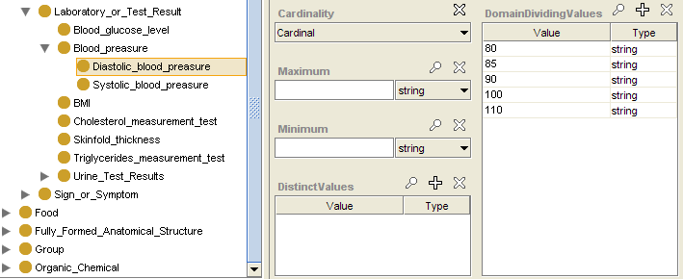
Diastolic blood pressure

Slide 10
Attribute creation algorithm
IF (cardinality == nominal OR cardinality == ordinal cyclic)
each value one category
return
ELSE IF (count of categories <= 5)
each value one category
return
ELSE
find the domain range (minimum, maximum)
IF (exist domain dividing values)
split according domain dividing values
IF (exist distinct values)
create category for each distinct value

Slide 11
Identification of semantically related attributes
Analytical question:
“What is the relation between blood pressure levels and hypertension?”
What are the attributes corresponding to blood pressure/hypertension?
Boxes asking for creation mechanism can help
Experiment

Slide 12
Conclusions
Implemented support for:
Mapping ontology and database concepts
Semi – automatic creation of right categorization
Identification of related attributes

